Slide 1

QER - 4837
QER: BID 141KM SF300065C004.4X – Weld crack at Zeta wire

Slide 2
Pipe section / Details
Item | Traceability / identification
Project number | SF300065C004
Project name | BID 141KM
Pipe section | SF300065C004.4X
ST number | ST101.51896
Affected layer / equipment | Spiralling
Length affected | 1) 3379.7m 2) 4303.1m
Drawing number / MP code / STA / Dimension | Zeta wire 6.2 FI09 (MP205)

Slide 3
Overview of anomaly
Problem Description :-
During the zeta spiraling process for BID 141KM SF300065C004.4X (ST10151896), weld crack was detected at length 3379.7m and 4303.5m during weld inspection after it was laid on the pipe.
Details of affected weld are as the following:-
- Weld number : 13-6 (During joint bobbin new loading)
- Welding machine : BS13-12
- Bobbin number : 005
- Weld number : 38-13 (Weld from winding process)
- Welding machine : BS13-11
- Bobbin number : 016
Root Cause :-
The root cause is to be investigated.
Problem Handling:-
The defective weld was rejected according to DP-QCP-08DAQT001. Therefore, un-spiraling was performed to remove the defective weld.
1st case at length 3379.7m, the affected weld is a joint bobbin new loading.
In addition, based on DI-IND-MET1075, the subsequent welds shall be retrieved if reachable for the test and analysis. The subsequent welds were gone through the tensile test, and the result is detailed below.
Tensile results for the subsequent welds:-
- Weld 14-06 (N+1) : 642.0mPa
The minimum criteria for the tensile test are 530mPa.
To note that, N-1 and N-2 welds are not retrievable due to have been laid on pipe at length 2886.6m and 2887.1m.
2nd case at length 4303.5m, the affected weld is from winding process.
In addition, based on DI-IND-MET1075, the subsequent welds shall be retrieved if reachable for the test and analysis. The subsequent welds were gone through the tensile test, and the result is detailed below.
Tensile results for the subsequent welds:-
- Weld 41-13 (N+3) : 616.2mPa
- Weld 42-13 (N+4) : 602.2mPa
The minimum criteria for the tensile test are 530mPa.
To note that, N-1 and N+1 welds are not retrievable due to have been laid on pipe at length 4195.5m and 3964.2m.

Slide 4
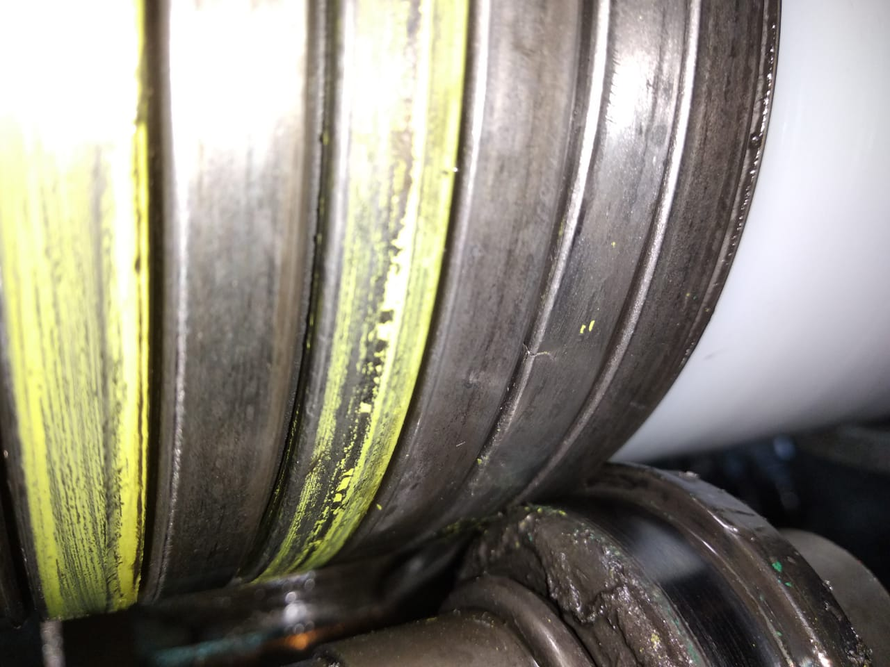
Wire weld crack length 3379.7m photo
Figure 1 : Weld crack was detected at length 3379.7m during weld inspection after it was laid on the pipe.

Slide 5
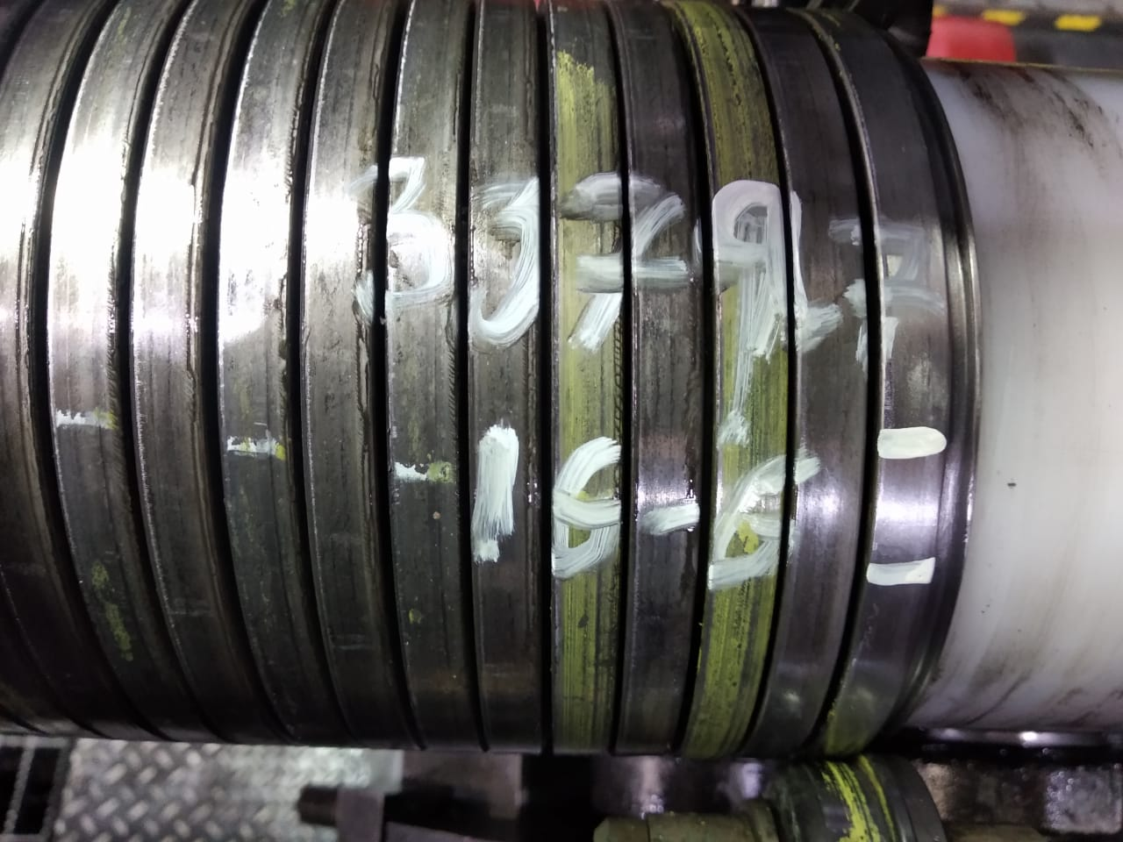
Photo after repaired
Figure 2 : Un-spiraling was performed to remove the defective weld and replace with new weld (16-6)

Slide 6
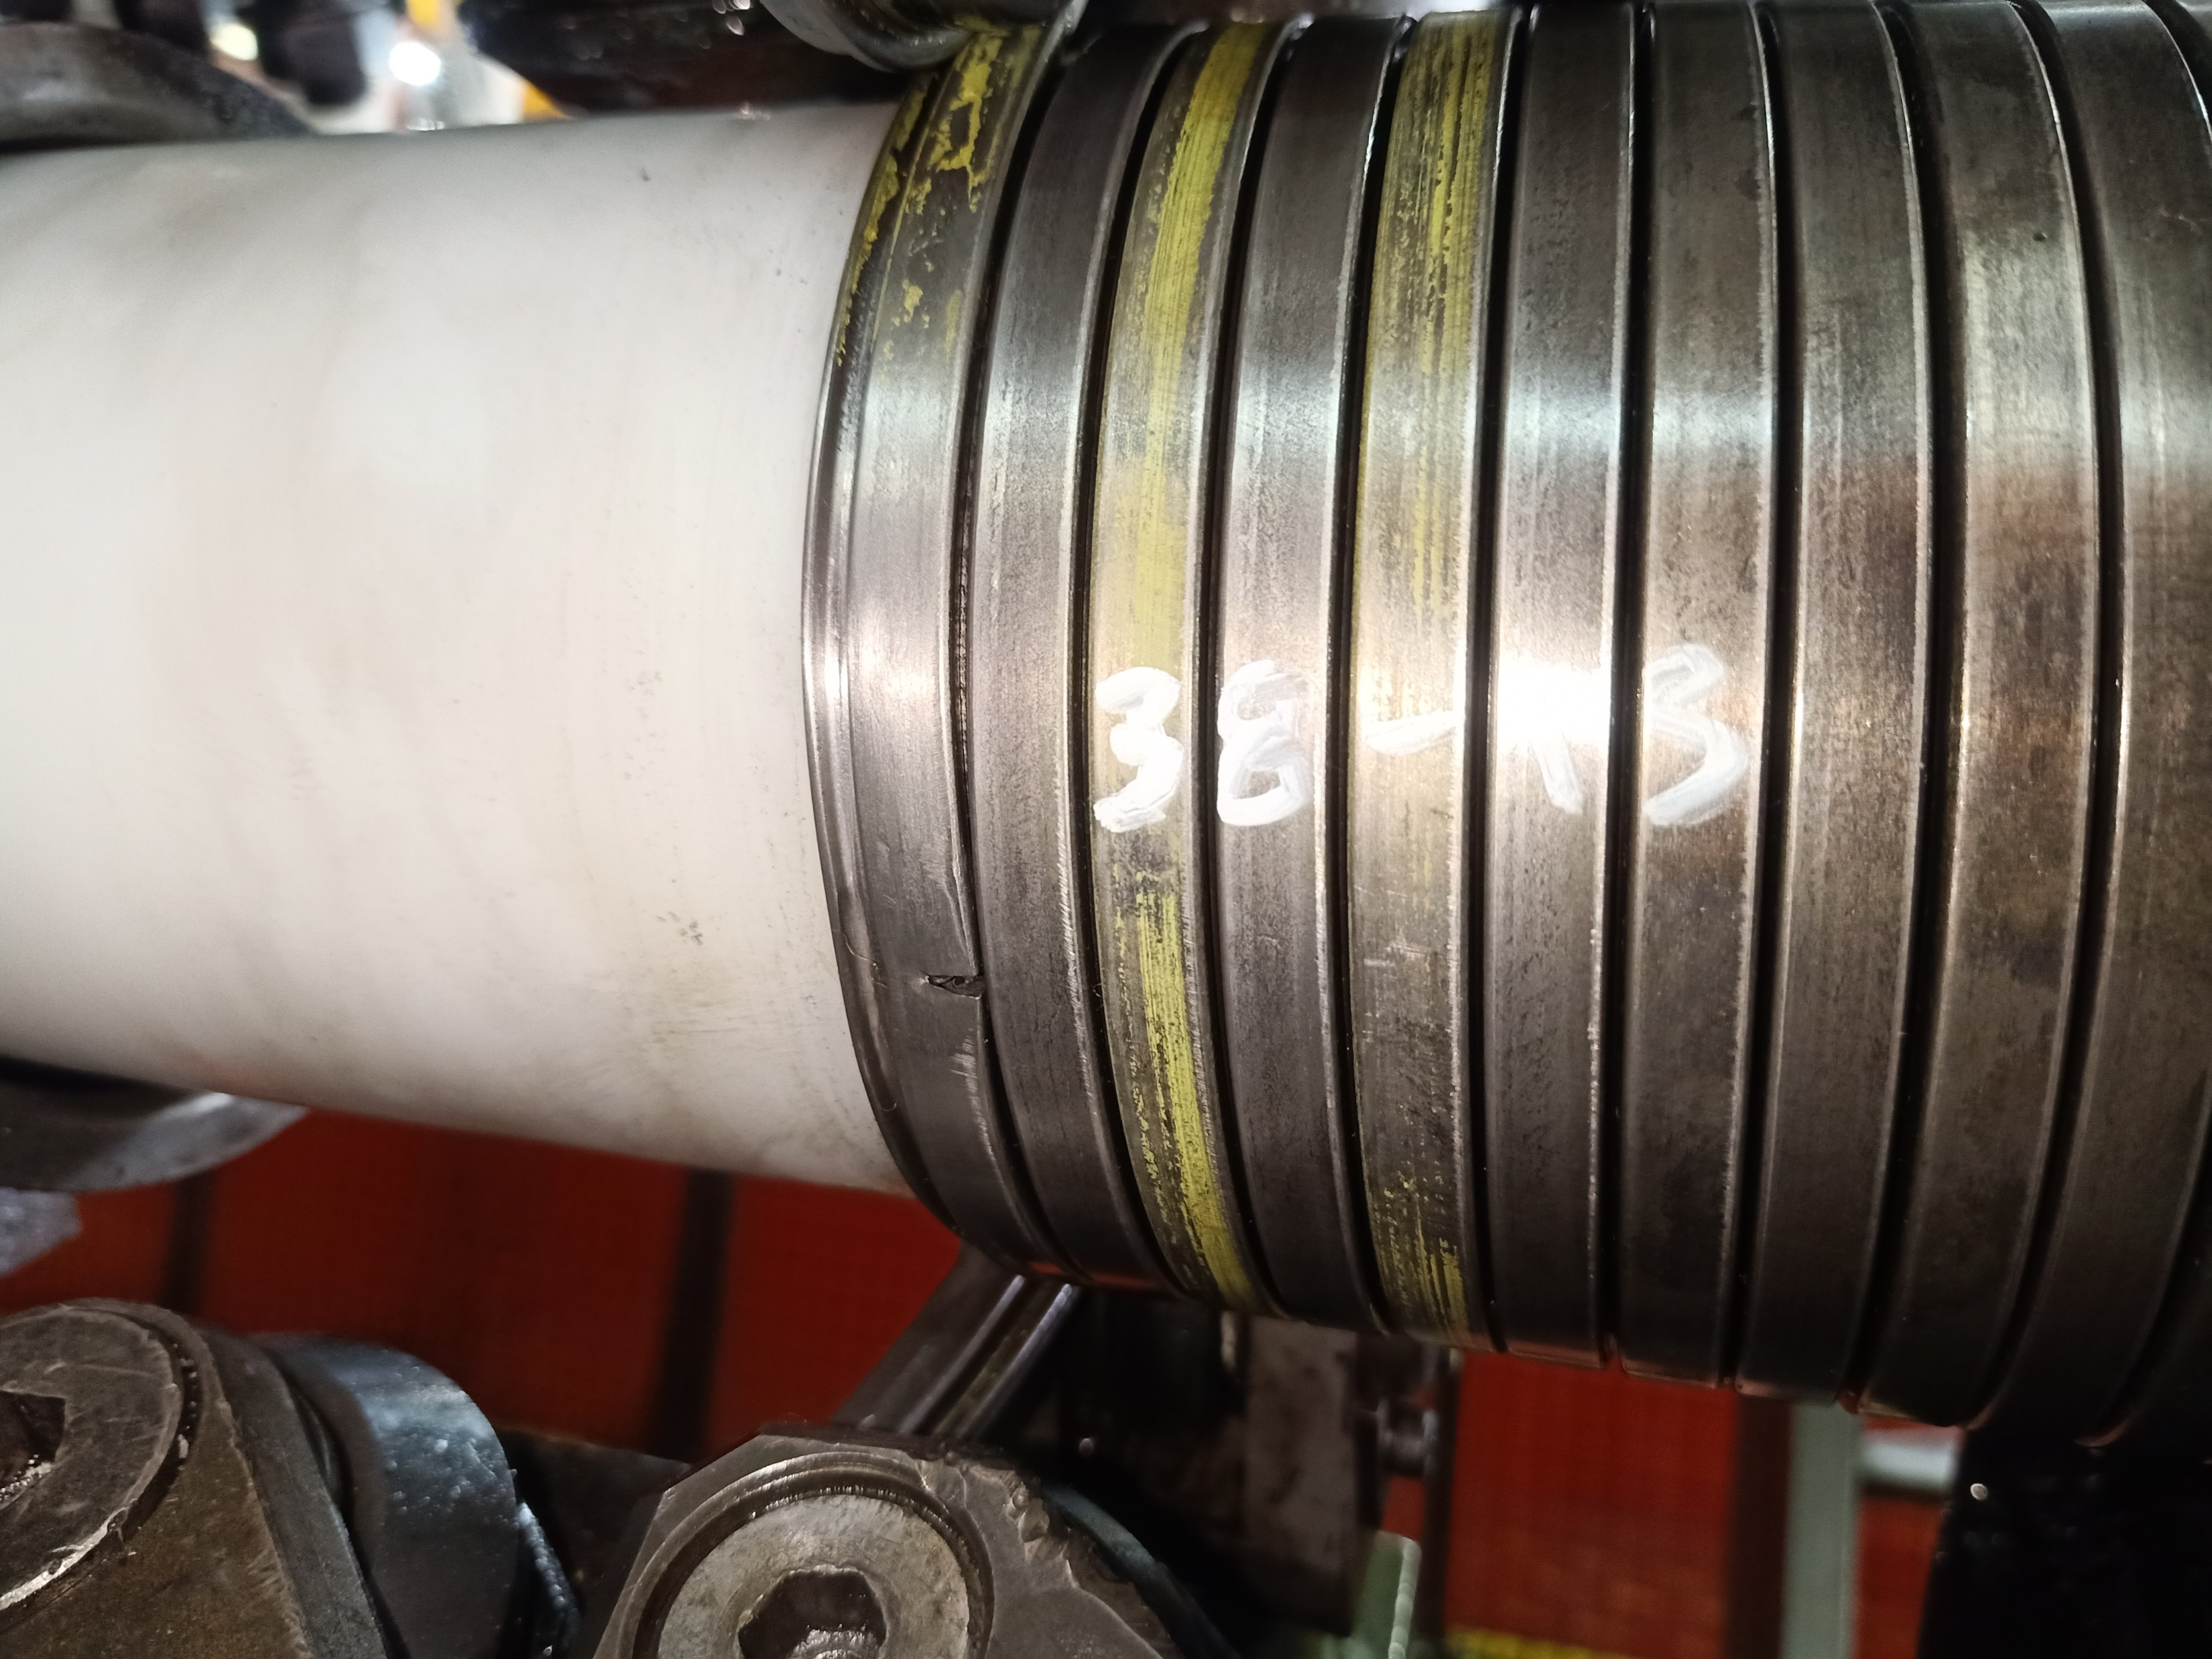
Wire weld crack length 4303.1m photo
Figure 3 : Weld crack was detected at length 4303.5m during weld inspection after it was laid on the pipe.

Slide 7
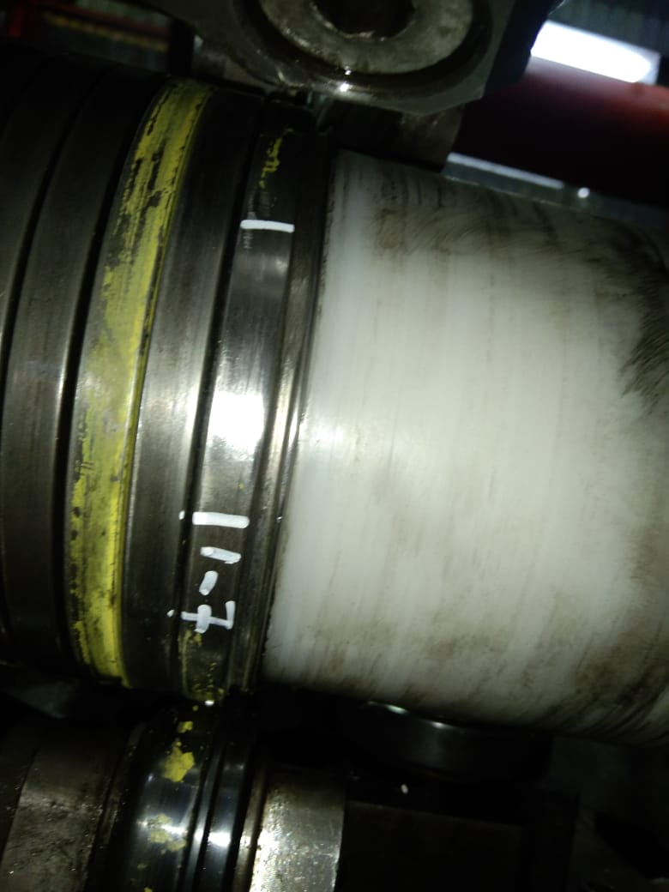
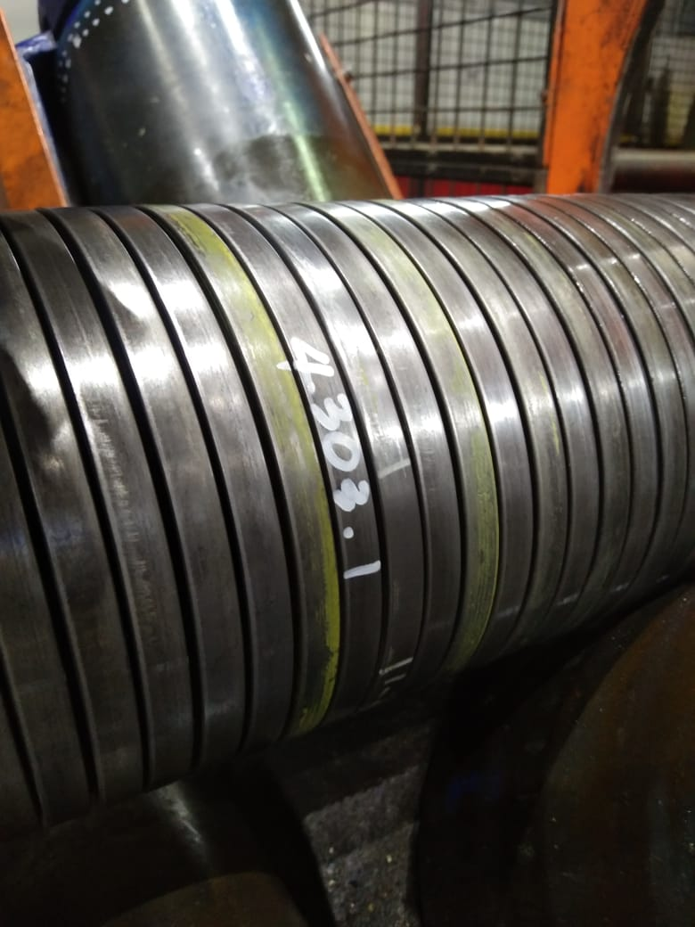
Photo after repaired
Figure 4 : Un-spiraling was performed to remove the defective weld and replace with new weld (1-7)

Slide 8

THANK YOU

